Slide 1


Bring the ME out of women
Team Abhyaas

Slide 2

“I have gone from being useful for my family for so long…to not having any purpose. I don’t know where to start again in order to find something to fulfil me”
Mrs. Singh, Houswife

Slide 3

3 out of 5 housewives in Mumbai in the age group of 45-60 said that the biggest struggle in their life is the lack of personal and growth opportunities.
1
“I feel too helpless…. I don’t know where to start”
2
“A part of me wishes I could go back and learn to be self dependent”
3
“I wish I knew more about what my children and husband do”
4
“Its too late for me to become self dependent”
5
“I don’t know how to do things like email setups, Instagram posts… ”

Slide 4
Team Abhyaas | Size and context of the problem
This helplessness has a real impact
15% of all suicides in India committed by housewives

Slide 5
Team Abhyaas | Size and context of the problem
Where can we put a dent?
40% urban housewives in the 40+ age bracket are looking for support to start a business
Source- EY

Slide 6
Team Abhyaas | Y-Combinator for middle class housewives in urban areas
Our proposed solution
6- month incubator program designed for Mumbai housewives in the age group of 45+ in their local language to help them commercialize their existing skillset¹.
1. Examples of skills in scope: Jewelry makers, candle artisans, food with a long shelf life

Slide 7
Team Abhyaas | Y-Combinator for middle class housewives in urban areas
6- month incubator program designed for Mumbai housewives in the age group of 45+ in their local language to help them commercialize their existing skillset.
1
2
3
Community building through mentorship and buddy programs
Skill development
on topics like financial management, ops, digital marketing, etc.
Empower women
to go from
“I can’t” to “I will”
1. Examples of skills in scope: Jewelry makers, candle artisans, food with a long shelf life

Slide 8
Team Abhyaas | MVP will be designed as a 6-month program targeted at 25 women in Mumbai
Roadmap from the incubator
Talent identification and onboarding
2-week Immersion
program
16-week
training
> 6 months
Expected outcomes
2
4
Focus on driving community building and confidence development
Incubator supports the entrepreneur to set up the business
3
Mix of business skill development and mentorship
1
25 women with an existing skillset will be identified through internal networks for the incubator
….the entire program will be designed to be completed within 200 hours

Slide 9

From…
…To
“I have the right business tools, community and mindset to build something valuable”
“I feel too helpless…. I don’t know where to start”

Slide 10
Team Abhyaas | Our aim is to build a self-sustaining and fiscally efficient incubator
An asset light model will help us deliver low cost of servicing for each entrepreneur
After two years, each entrepreneur will pay for themselves and another individual
$180
$360
Primary source of revenues
Each entrepreneur will have two years to start a business and pay 30K through commissions on product sales. After that, they have to pay the remaining lump sum amount.
Grants and donations
Secondary source of revenues

Slide 11


Team Abhyaas | Key 5-year target metrics for success
1
2
500+
$3 Million
New women entrepreneurs
Additional revenue created

Slide 12
Team Abhyaas | Other 5-year metrics for internal success
50%
% housewives who enroll in the program should start a business
80%
% participants should recommend the program to someone in their network
4 out of 5
Participants should feel that the program notably improved their mental health
100k+
Social media community size
Others….

Slide 13

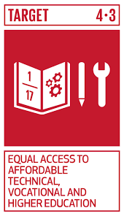











Team Abhyaas | Social impact across all SDGs
SDG 4
Other SDGs

Slide 14
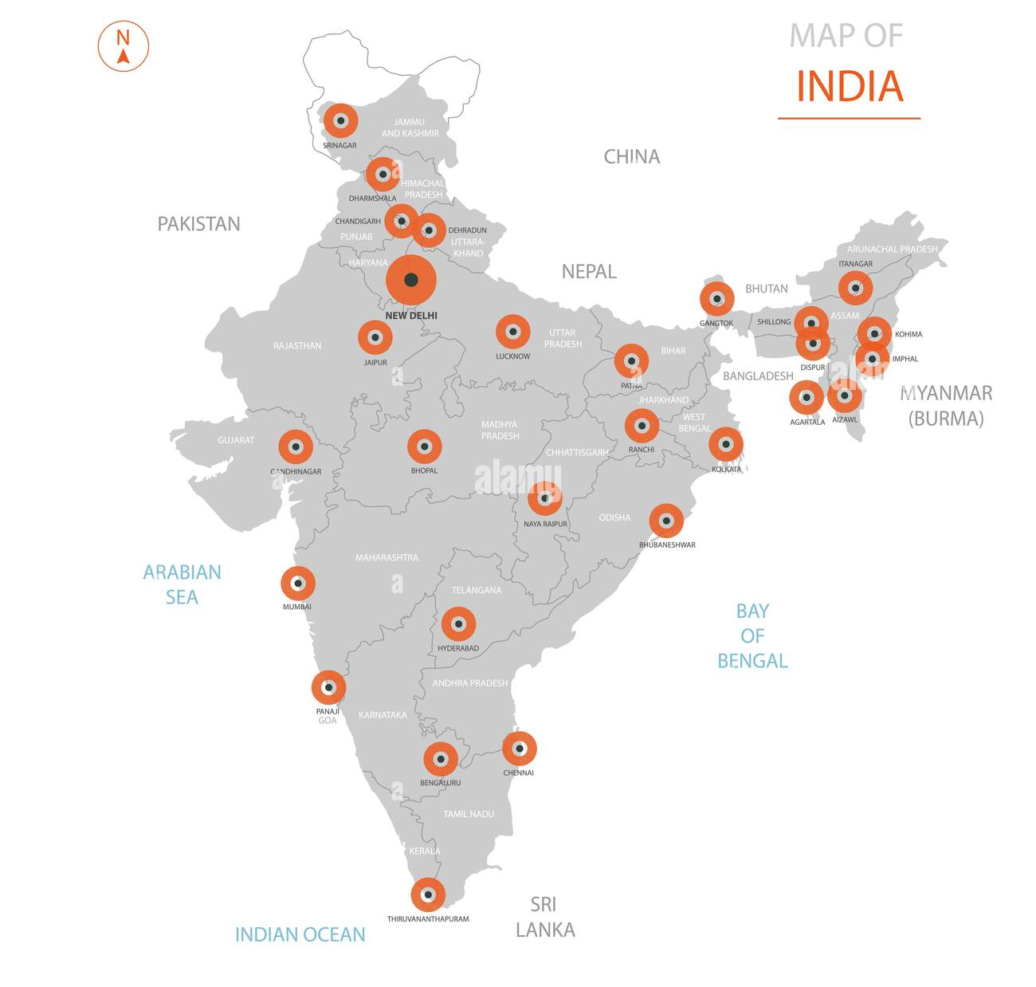
Team Abhyaas | Post MVP stage, the program will offer immense scope for scalability across India
20+ Cities
100m+ housewives
$700B of uncovered gig economy value

Slide 15

7 Gujarati women turned ₹80 into ₹1600 Crores employing more than 45000 lives. Imagine the impact when the glass ceiling starts cracking for Indian housewives.

Slide 16
Contact us for how we can build this together

Slide 17
Appendix
Team Abhyaas

Slide 18
Team Abhyaas |6+ months- how will we make money and how will the product journey look
Talent identification and onboarding
2-week Immersion
program
Training
program
Post
incubator
1
2
3
4
Identification through internal networks/local exhibitions
Sign ups enter a 2-week immersion program
Focus on motivation and community building
2-hour sessions/
3 days a week
All entrepreneurs enter the 4 months training program
Focus on building financial, ops and marketing skills
8 hours per week including self paced learning
Entrepreneurs start building the startup
4 weeks of intensive mentor and Combinator support
High level details
Simple sign-up process via WhatsApp (local language)
Self sustaining & profitable biz operations

Slide 19


Team Abhyaas | Y-Combinator for middle class housewives in urban areas
6- month incubator program designed for Mumbai housewives in the age group of 45+ in their local language to help them commercialize their existing skillset.
1
2
3
Community building through mentorship and buddy programs
Skill development on topics like financial management, ops, digital marketing, etc.
Support ecosystem to
empower women to go from
“I can’t” to “I will”
Target users and prerequisites
Urban Mumbai housewives
45–50-year age range
Existing skillset that can be commercialized¹
Basic literacy skills (can read and write)
1. Examples of skills in scope: Jewelry makers, candle artisans, food with a long shelf life

Slide 20
Team Abhyaas | Y-Combinator for middle class housewives in urban areas
From…
…to
1
“I feel too helpless…. I don’t know where to start”
“I have the right business tools, community and mindset to build something valuable”
2
“A part of me wishes I could go back and learn to be self dependent”
“It’s never late to learn new skills and I will push women around me to think the same way”
3
“I wish I knew more about what my children and husband do”
“I don’t feel nervous about asking people questions even if I don’t know something”
4
“It’s too late for me to become self dependent”
“I value my financial and emotional independence”
5
“I don’t know how to do things like email setups, Instagram posts… ”
“I feel comfortable using technology and am confident that can learn new things quickly”

Slide 21
Team Abhyaas | MVP will be designed as a 6-month program targeted at 25 women in Mumbai
Talent identification and onboarding
2-week Immersion
program
16 week
training
Post
incubator
1
2
3
4
Expected outcomes
25 women with existing skillset sign up for the program
Each woman will feel empowered to build something valuable
Each woman will feel that they have right tools to start a business
Entrepreneurs will set the foundation for their successful business
Identification through internal networks/local exhibitions
2-hour sessions/
3 days a week
8 hours per week including self paced learning
Entrepreneurs start their business using a 4-week intensive build program supported by the incubator
High level details
Simple sign-up process via WhatsApp (local language)
Leadership sessions
Mentorship program
Buddy program
Field visits
Training courses
Practical assignments
Ongoing mentorship
Buddy program
Pay the incubator 30K within 2 years

